Slide 1
MURAKOZE WALLET
A Third-Party Payment Initiation (3PPI) Integration via MOJALOOP (Real-time Payment System)

Slide 2
OUTLINE
Context
Motivation
Current Implementation Plan
Current Solution
RTP-Based Solution
Mojaloop solution overview
Demo
Challenges

Slide 3
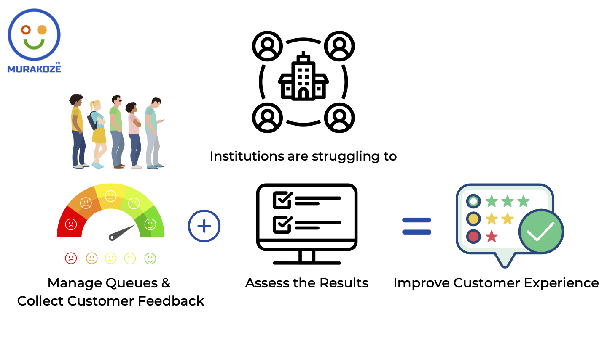
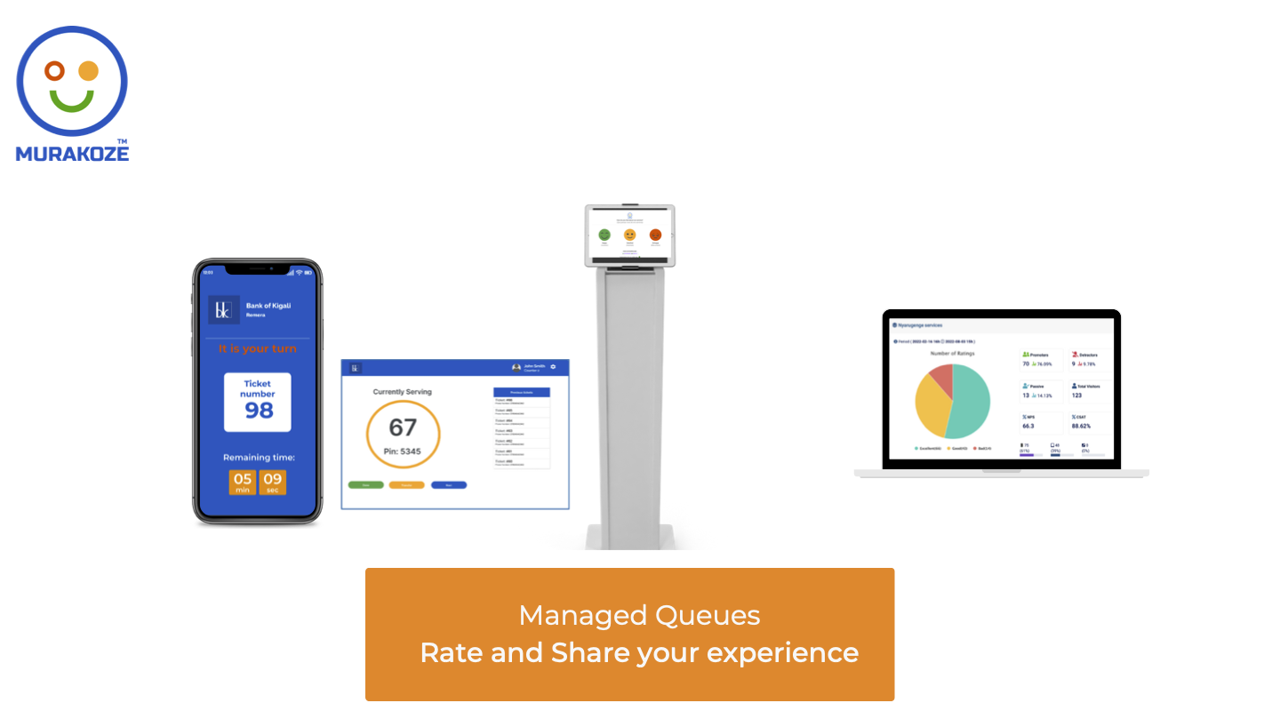
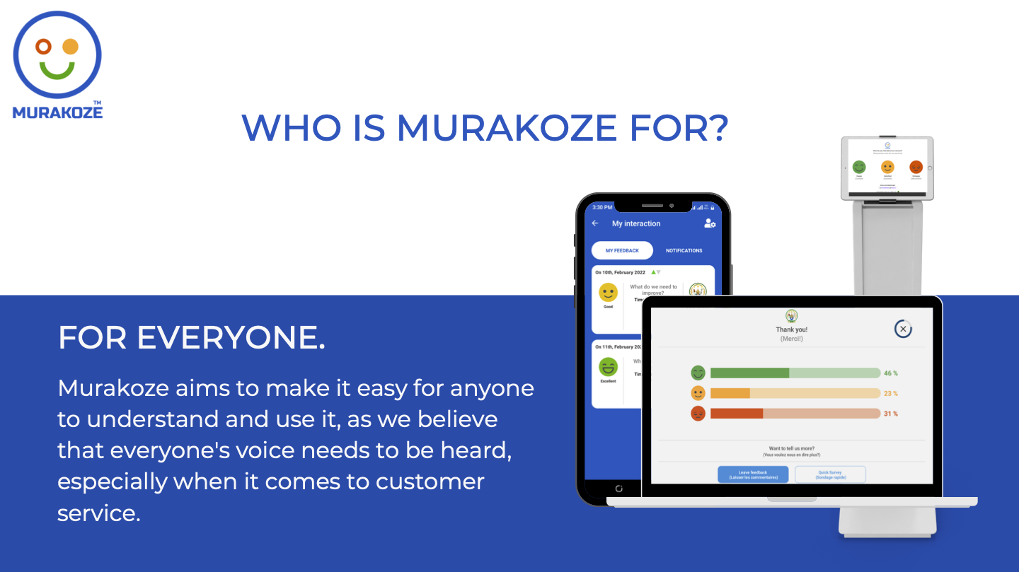
CONTEXT: WHAT IS MURAKOZE?
A customer experience rating & feedback platform
A service Queue Management System

Slide 4
MOTIVATION: WHY A PAYMENT WALLET?
To hide Payer account information from Payee
Ability to pay from my different wallets and accounts
*135*R*You have received 8500 RWF from JOHN DOE (250799000111) on your mobile money account at 2023-02-25 15:53:58. Message from sender: 8500.Your new balance:40165 RWF.Thank you for using MTN MobileMoney.*EN#

Slide 5
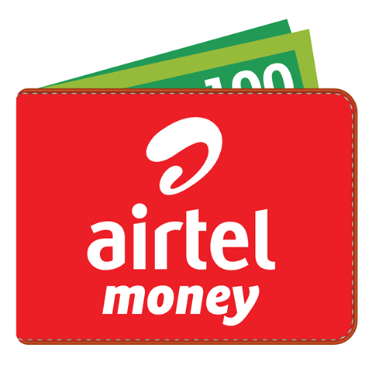





CURRENT IMPLEMENTATION PLAN
MURAKOZE WALLET
(PISP)

Slide 6




CURRENT SOLUTION (REPLICATED N-TIMES)
Payment Confirmation Request
(USSD Push Notification)
3
Payer
2
Payer FSP
1
4
MURAKOZE WALLET
(PISP)
5
6
Payee FSP
Payee

Slide 7
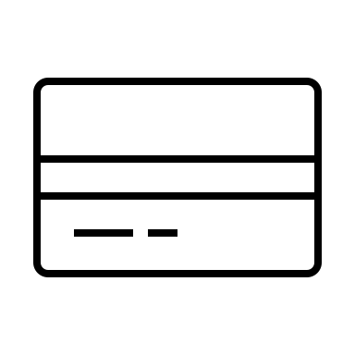
RTP-BASED SOLUTION
Payer FSP
MURAKOZE WALLET
(PISP)
3
Third-Party Payment Initiation
2
1
RTP System
(RNDPS)
4
Payer
Payee FSP
5
Payee

Slide 8
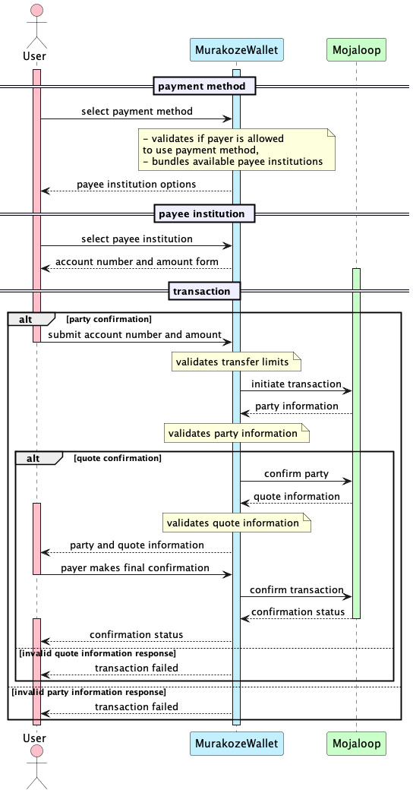
MOJALOOP SOLUTION OVERVIEW

Slide 9
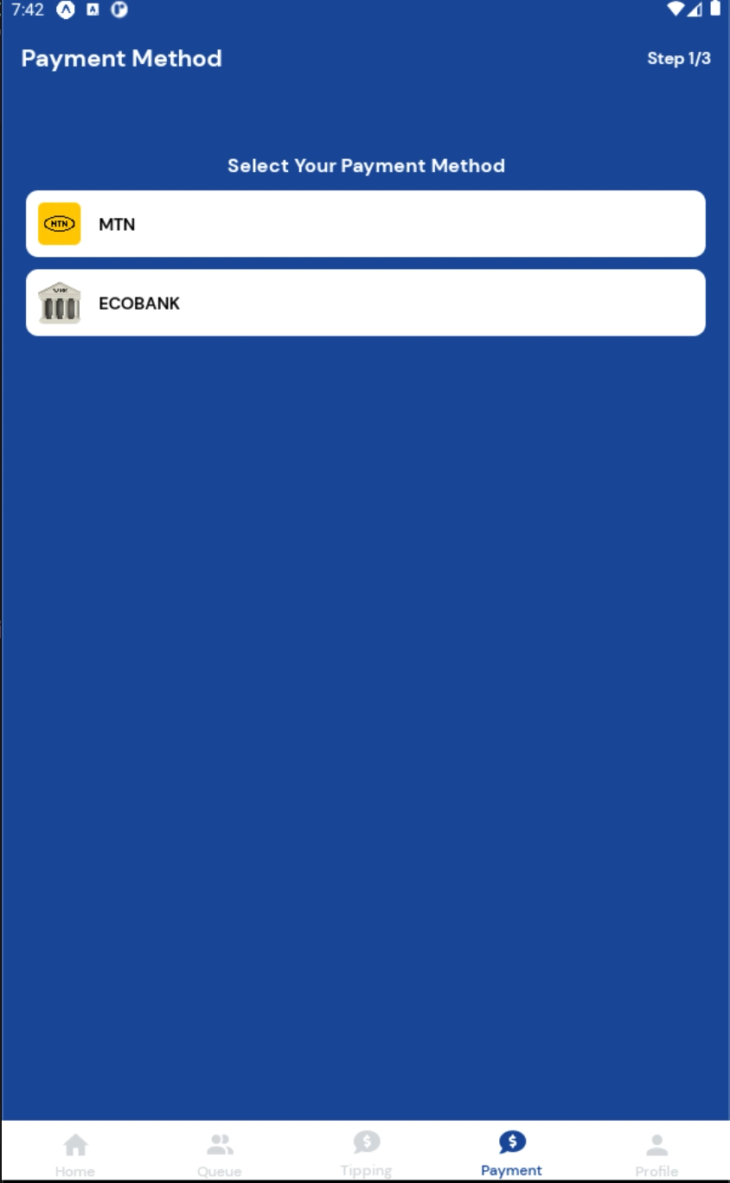
DEMO

Slide 10
CHALLENGES
Limited UI customizations options, this is on some of the options like. Requires a lot of effort to make user interface changes that should normally be given in environment configurations of application configurations.
Not so clear mapping between fspids and they are actual generic names. We would like to be able to have fspid but able to be mapped to a human readable FSP name like MTN, Bank of Kigali and so on.
APIs are not very well documented. Sometimes we would struggle to understand what the actual fields mean and that wouldn't necessarily be explicitly called out in API documentations (Swaggers).
Hard for us to understand fees structure in Mojaloop. Fun fact (We still don’t know the difference between payeeFspFee & payeeFspCommission)

Slide 11
THANK YOU

